Slide 1
Big Data and Cloud Computing: New Wine or just New Bottles?
VLDB’2010 Tutorial
Divy Agrawal, Sudipto Das, and Amr El Abbadi
Department of Computer Science
University of California at Santa Barbara

Slide 2

A Voice from the Above
…Cloud Computing? What are you
talking about? Cloud Computing is
nothing but a computer attached to
a network.
-- Larry Ellison, Excerpts from an interview

Slide 3










WEB is replacing the Desktop
Notes:
As we all know – WEB based services and applications are replacing desktop applications. There are numerous examples – and using my own experience – I guess that more than 50% of my computer interactions involve accessing Web applications.
This trend is not likely to change instead it will continue on this trajectory.
Even for internal and in-house applications – we access them through a Web browser.
So clearly – there is a permanent shift towards service-oriented computing.

Slide 4













Paradigm Shift in Computing

Slide 5

Blurring the Boundaries: Physical & Virtual

Slide 6
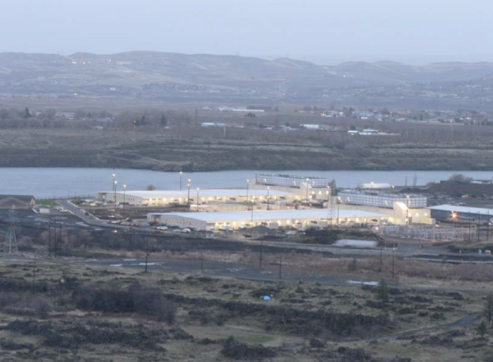
Warehouse Scale Computing
16 Million Nodes per building

Slide 7
What is Cloud Computing?
Old idea: Software as a Service (SaaS)
Def: delivering applications over the Internet
Recently: “[Hardware, Infrastructure, Platform] as a service”
Poorly defined so we avoid all “X as a service”
Utility Computing: pay-as-you-go computing
Illusion of infinite resources
No up-front cost
Fine-grained billing (e.g. hourly)

Slide 8
Cloud Computing: Why Now?
Experience with very large datacenters
Unprecedented economies of scale
Transfer of risk
Technology factors
Pervasive broadband Internet
Maturity in Virtualization Technology
Business factors
Minimal capital expenditure
Pay-as-you-go billing model

Slide 9
Economics of Cloud Users
Pay by use instead of provisioning for peak
Capacity
Resources
Resources
Demand
Capacity
Demand
Time
Time
Static data center
Data center in the cloud
Unused resources
Slide Credits: Berkeley RAD Lab

Slide 10
Economics of Cloud Users
Risk of over-provisioning: underutilization
Capacity
Unused resources
Resources
Demand
Time
Static data center
Slide Credits: Berkeley RAD Lab

Slide 11
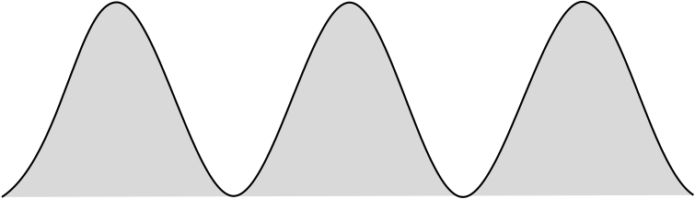
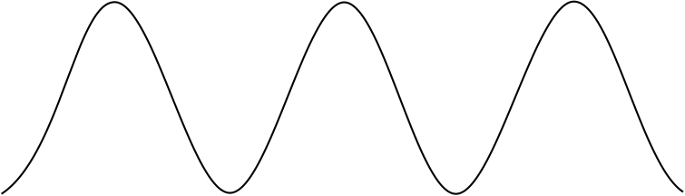
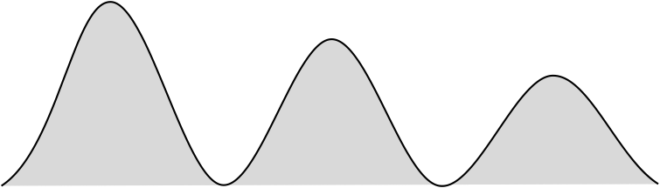

Economics of Cloud Users
Heavy penalty for under-provisioning
Resources
Capacity
Demand
Resources
Capacity
1
2
3
Time (days)
Demand
Lost revenue
1
2
3
Time (days)
Resources
Capacity
Demand
1
2
3
Time (days)
Lost users
Slide Credits: Berkeley RAD Lab

Slide 12
The Big Picture
Unlike the earlier attempts:
Distributed Computing
Distributed Databases
Grid Computing
Cloud Computing is REAL:
Organic growth: Google, Yahoo, Microsoft, and Amazon
Poised to be an integral aspect of National Infrastructure in US and elsewhere (Singapore IDA)

Slide 13
Cloud Reality
Facebook Generation of Application Developers
Animoto.com:
Started with 50 servers on Amazon EC2
Growth of 25,000 users/hour
Needed to scale to 3,500 servers in 2 days (RightScale@SantaBarbara)
Many similar stories:
RightScale
Joyent
…

Slide 14
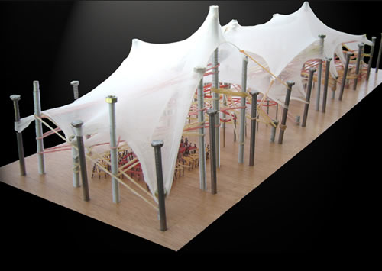

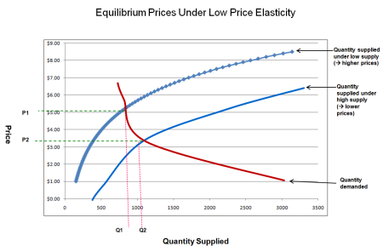

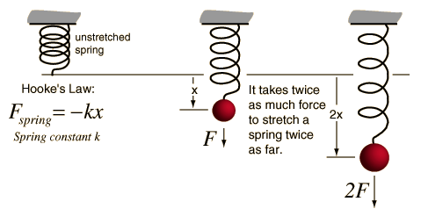
Cloud Challenges: Elasticity

Slide 15

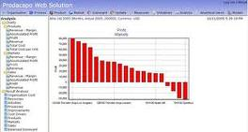

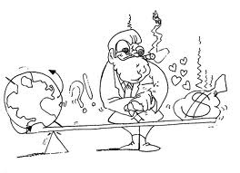
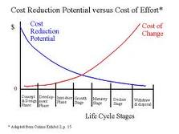
Cloud Challenges: Differential Pricing Models

Slide 16
Outline
Data in the Cloud
Platforms for Data Analysis
Platforms for Update intensive workloads
Data Platforms for Large Applications
Multitenant Data Platforms
Open Research Challenges

Slide 17
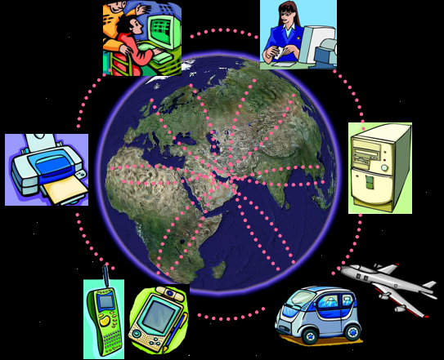
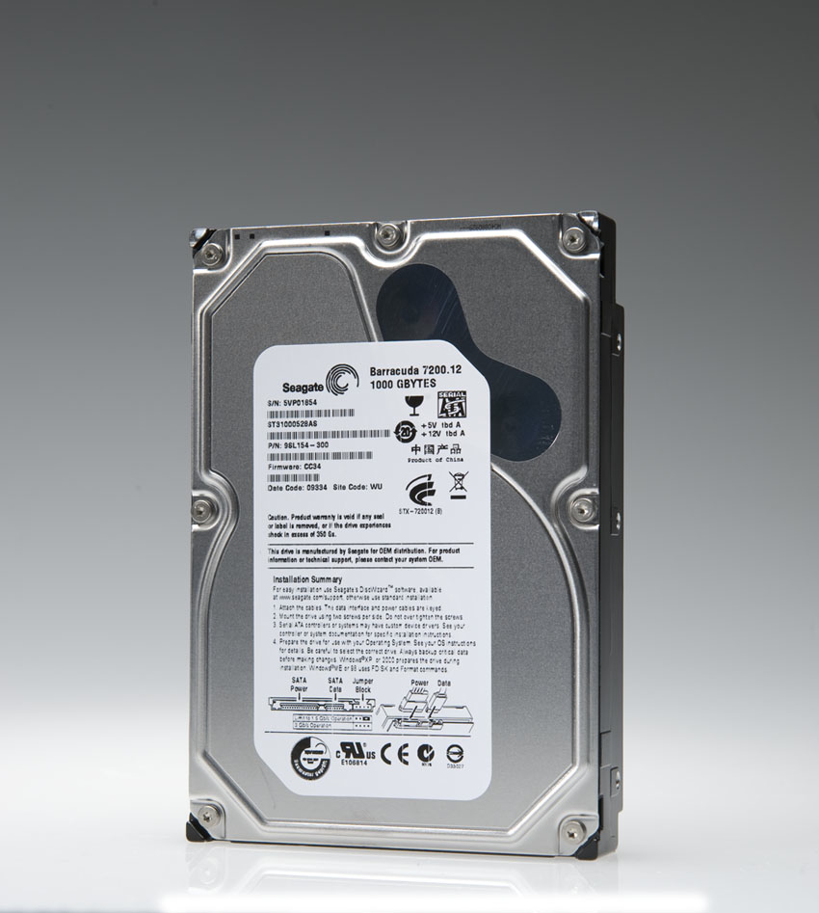
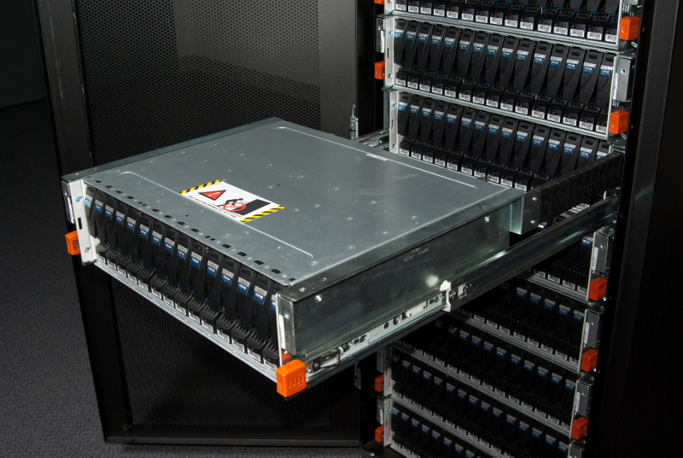
Data-rich World
Data capture and collection:
Highly instrumented environment
Sensors and Smart Devices
Network
Data storage:
Seagate 1 TB Barracuda @ $72.95 from Amazon.com (73¢/GB)

Slide 18
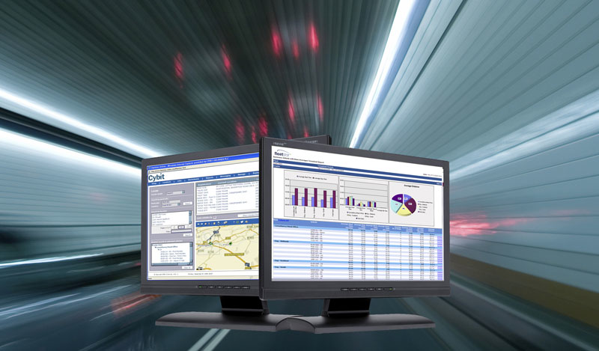
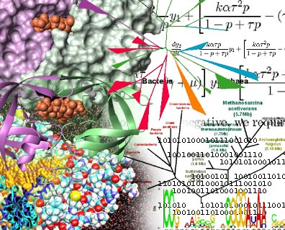

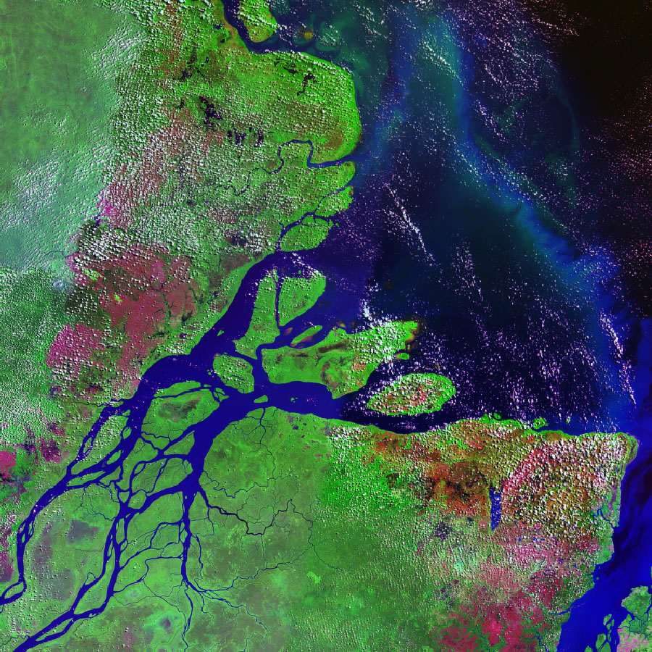
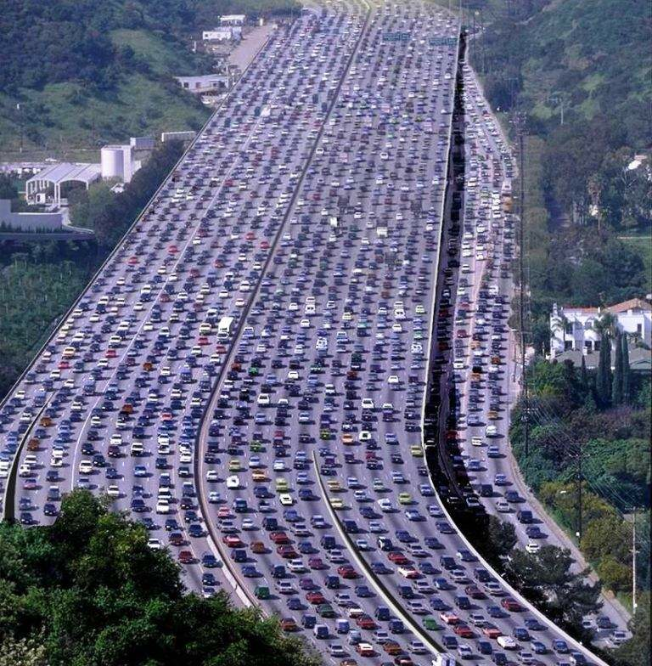

What can we do with this wealth?
What can we do?
Scientific breakthroughs
Business process efficiencies
Realistic special effects
Improve quality-of-life: healthcare, transportation, environmental disasters, daily life, …
Could We Do More?
YES: but need major advances in our capability to analyze this data

Slide 19


Cloud Computing Modalities
“Can we outsource our IT software and hardware infrastructure?”
“We have terabytes of click-stream data – what can we do with it?”
Hosted Applications and services
Pay-as-you-go model
Scalability, fault-tolerance, elasticity, and self-manageability
Very large data repositories
Complex analysis
Distributed and parallel data processing

Slide 20
Outline
Data in the Cloud
Platforms for Data Analysis
Platforms for Update intensive workloads
Data Platforms for Large Applications
Multitenant Data Platforms
Open Research Challenges

Slide 21
Why Data Analysis?
Who are our lowest/highest margin customers ?
Who are my customers and what products are they buying?
What is the most effective distribution channel?
What product prom- -otions have the biggest impact on revenue?
Which customers are most likely to go to the competition ?
What impact will new products/services
have on revenue and margins?

Slide 22
Decision Support
Used to manage and control business
Data is historical or point-in-time
Optimized for inquiry rather than update
Use of the system is loosely defined and can be ad-hoc
Used by managers and end-users to understand the business and make judgements

Slide 23
Decision Support
Data-analysis in the enterprise context emerged:
As a tool to build decision support systems
Data-centric decision making instead of using business-intuition
New term: Business Intelligence
Traditional approach:
Decision makers wait for reports from disparate OLTP systems
Put it all together in a spread-sheet
Highly manual process

Slide 24
Data Analytics in the Web Context
Data capture at the user interaction level:
in contrast to the client transaction level in the Enterprise context
As a consequence the amount of data increases significantly
Greater need to analyze such data to understand user behaviors

Slide 25
Our Data-driven World
Science
Data bases from astronomy, genomics, environmental data, transportation data, …
Humanities and Social Sciences
Scanned books, historical documents, social interactions data, …
Business & Commerce
Corporate sales, stock market transactions, census, airline traffic, …
Entertainment
Internet images, Hollywood movies, MP3 files, …
Medicine
MRI & CT scans, patient records, …

Slide 26
Data Analytics in the Cloud
Scalability to large data volumes:
Scan 100 TB on 1 node @ 50 MB/sec = 23 days
Scan on 1000-node cluster = 33 minutes
➔ Divide-And-Conquer (i.e., data partitioning)
Cost-efficiency:
Commodity nodes (cheap, but unreliable)
Commodity network
Automatic fault-tolerance (fewer admins)
Easy to use (fewer programmers)

Slide 27
Platforms for Large-scale Data Analysis
Parallel DBMS technologies
Proposed in the late eighties
Matured over the last two decades
Multi-billion dollar industry: Proprietary DBMS Engines intended as Data Warehousing solutions for very large enterprises
Map Reduce
pioneered by Google
popularized by Yahoo! (Hadoop)

Slide 28
Parallel DBMS technologies
Popularly used for more than two decades
Research Projects: Gamma, Grace, …
Commercial: Multi-billion dollar industry but access to only a privileged few
Relational Data Model
Indexing
Familiar SQL interface
Advanced query optimization
Well understood and studied

Slide 29
MapReduce [Dean et al., OSDI 2004, CACM Jan 2008, CACM Jan 2010]
Overview:
Data-parallel programming model
An associated parallel and distributed implementation for commodity clusters
Pioneered by Google
Processes 20 PB of data per day
Popularized by open-source Hadoop project
Used by Yahoo!, Facebook, Amazon, and the list is growing …

Slide 30
Programming Framework
Raw Input: <key, value>
MAP
<K1, V1>
<K2,V2>
<K3,V3>
REDUCE

Slide 31
MapReduce Advantages
Automatic Parallelization:
Depending on the size of RAW INPUT DATA ➔ instantiate multiple MAP tasks
Similarly, depending upon the number of intermediate <key, value> partitions ➔ instantiate multiple REDUCE tasks
Run-time:
Data partitioning
Task scheduling
Handling machine failures
Managing inter-machine communication
Completely transparent to the programmer/analyst/user

Slide 32
MapReduce Experience
Runs on large commodity clusters:
1000s to 10,000s of machines
Processes many terabytes of data
Easy to use since run-time complexity hidden from the users
1000s of MR jobs/day at Google (circa 2004)
100s of MR programs implemented (circa 2004)

Slide 33
The Need
Special-purpose programs to process large amounts of data: crawled documents, Web Query Logs, etc.
At Google and others (Yahoo!, Facebook):
Inverted index
Graph structure of the WEB documents
Summaries of #pages/host, set of frequent queries, etc.
Ad Optimization
Spam filtering

Slide 34
MapReduce Contributions
Simple & Powerful
Programming Paradigm
For
Large-scale Data Analysis
Run-time System
For
Large-scale Parallelism & Distribution

Slide 35
Takeaway
MapReduce’s data-parallel programming model hides complexity of distribution and fault tolerance
Principal philosophies:
Make it scale, so you can throw hardware at problems
Make it cheap, saving hardware, programmer and administration costs (but requiring fault tolerance)
Hive and Pig further simplify programming
MapReduce is not suitable for all problems, but when it works, it may save you a lot of time

Slide 36
Map Reduce vs Parallel DBMS [Pavlo et al., SIGMOD 2009, Stonebraker et al., CACM 2010, …]
 | Parallel DBMS | MapReduce
Schema Support | ✓ | Not out of the box
Indexing | ✓ | Not out of the box
Programming Model | Declarative (SQL) | Imperative (C/C++, Java, …) Extensions through Pig and Hive
Optimizations (Compression, Query Optimization) | ✓ | Not out of the box
Flexibility | Not out of the box | ✓
Fault Tolerance | Coarse grained techniques | ✓

Slide 37

MapReduce: A step backwards?
Don’t need 1000 nodes to process petabytes:
Parallel DBs do it in fewer than 100 nodes
No support for schema:
Sharing across multiple MR programs difficult
No indexing:
Wasteful access to unnecessary data
Non-declarative programming model:
Requires highly-skilled programmers
No support for JOINs:
Requires multiple MR phases for the analysis

Slide 38
MapReduce VS Parallel DB: Our 2¢
Web application data is inherently distributed on a large number of sites:
Funneling data to DB nodes is a failed strategy
Distributed and parallel programs difficult to develop:
Failures and dynamics in the cloud
Indexing:
Sequential Disk access 10 times faster than random access.
Not clear if indexing is the right strategy.
Complex queries:
DB community needs to JOIN hands with MR

Slide 39
Data Analytics in the Cloud New Challenges and Opportunities

Slide 40
Conjectures
New breed of Analysts:
Information-savvy users
Most users will become nimble analysts
Most transactional decisions will be preceded by a detailed analysis
Convergence of OLAP and OLTP:
Both from the application point-of-view and from the infrastructure point-of-view

Slide 41
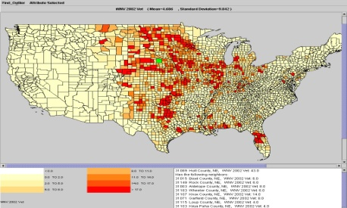
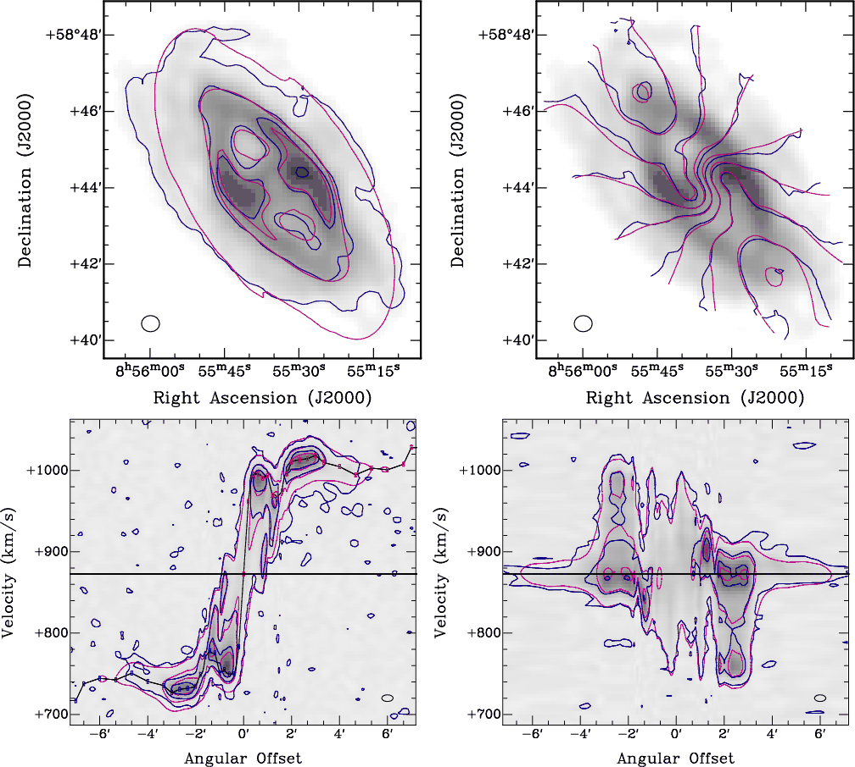
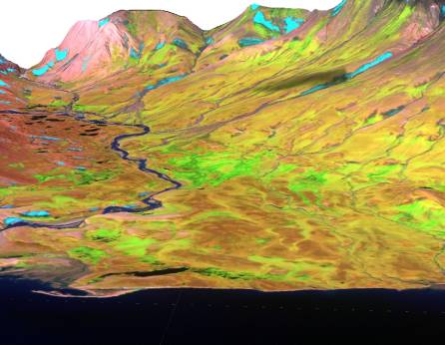
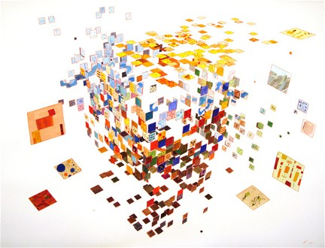
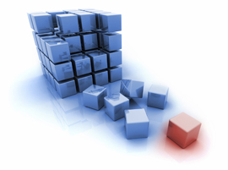
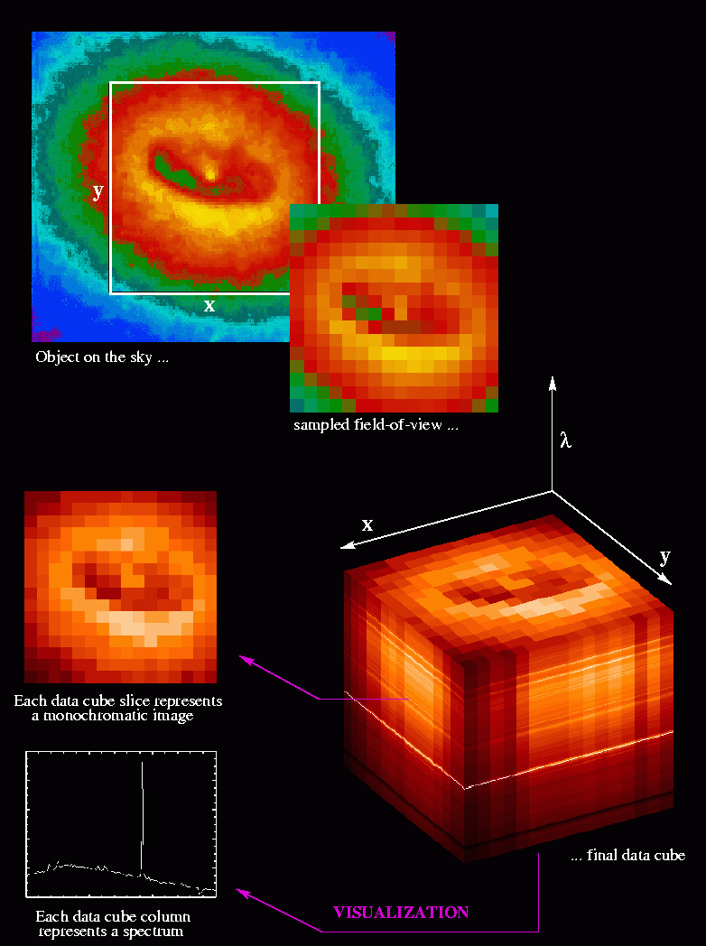
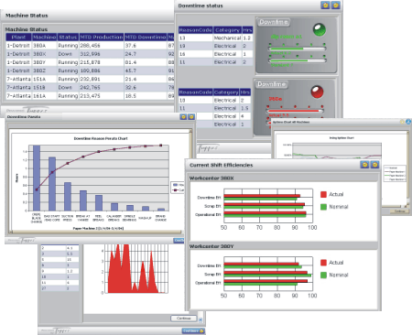
Data Analytics Evolution
Future: Learning?
Strategic: Mining &
Statistics
Tactical:
Data Analysis
Operational:
Reporting

Slide 42
Data Analytics Needs
Very large data-sets
Different types of data-sets
No longer confined to confined to summarization and aggregation
Rather:
Complex analyses based on data mining and statistical techniques
Question:
Should this all be integrated at the level of SQL constructs?

Slide 43
Leveraging DBMS Technology for Scalable Analytics

Slide 44
Scalable Analytics Innovations
Asynchronous Views over Cloud Data
Yahoo! Research (SIGMOD’2009)
DataPath: Data-centric Analytic Engine
U Florida (Dobra) & Rice (Jermaine) (SIGMOD’2010)
MapReduce innovations:
MapReduce Online (UCBerkeley)
HadoopDB (Yale)
Multi-way Join in MapReduce (Afrati&Ullman: EDBT’2010)

Slide 45
Key-value Stores
Data-stores for Web applications & analytics:
PNUTS, BigTable, Dynamo, …
Massive scale:
Scalability, Elasticity, Fault-tolerance, & Performance
Weak consistency
ACID
Simple queries
Not-so-simple queries
SQL
Views over Key-value Stores

Slide 46
Simple to Not-so-simple Queries
Simple
Not-so-simple
SQL
0
Primary access
Point lookups
Range scans
Secondary access
Joins
Group-by aggregates

Slide 47
Secondary Access
Reviews(review-id,user,item,text)
1 | Dave | TV | …
2 | Jack | GPS | …
4 | Alex | DVD | …
5 | Jack | TV | …
7 | Dave | GPS | …
8 | Tim | TV | …
Reviews for TV
ByItem(item,review-id,user,text)
GPS | 2 | Jack | …
GPS | 7 | Dave | …
TV | 1 | Dave | …
TV | 5 | Jack
TV | 8 | Tim | …
DVD | 4 | Alex | …
View records are replicas with a different primary key
ByItem is a remote view

Slide 48
Remote View = Ordered PNUTS Table
☺
☺
US
Europe
Remote view
scale
latency
fault tolerance
consistency
system complexity
asynchronous
view treated as a replica
low
Reuse lots of replication mechanisms

Slide 49
Remote View Maintenance
Clients
☺
API
Query Routers
disk write in log
cache write in storage
return to user
flush to disk
remote view maintenance
view log message(s)
view update(s) in storage
Log Managers
f
☺
a
d
b
g
e
g
Storage Servers
Remote Maintainer

Slide 50
Remote Views
Reviews(review-id,user,item,text)
1 | Dave | TV | …
2 | Jack | GPS | …
4 | Alex | DVD | …
5 | Jack | TV | …
7 | Dave | GPS | …
8 | Tim | TV | …
DVD
ByItem(item,review-id,user,text)
DVD | 4 | Alex | …
GPS | 2 | Jack | …
GPS | 7 | Dave | …
TV | 1 | Dave | …
TV | 5 | Jack
TV | 8 | Tim | …
DVD | 8 | Tim | …
Remote view maintainer does a constant amount of work for each update
Remote views provide secondary access

Slide 51
Hadoop DB – A Hybrid Approach [Abouzeid et al., VLDB 2009]
An architectural hybrid of MapReduce and DBMS technologies
Use Fault-tolerance and Scale of MapReduce framework like Hadoop
Leverage advanced data processing techniques of an RDBMS
Expose a declarative interface to the user
Goal: Leverage from the best of both worlds

Slide 52
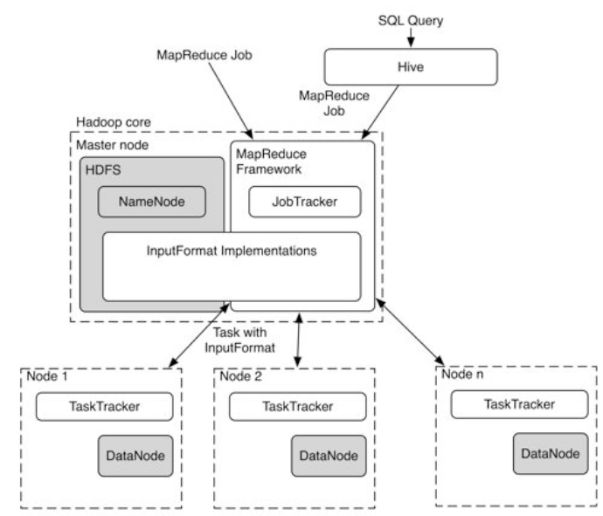
Architecture of HadoopDB

Slide 53
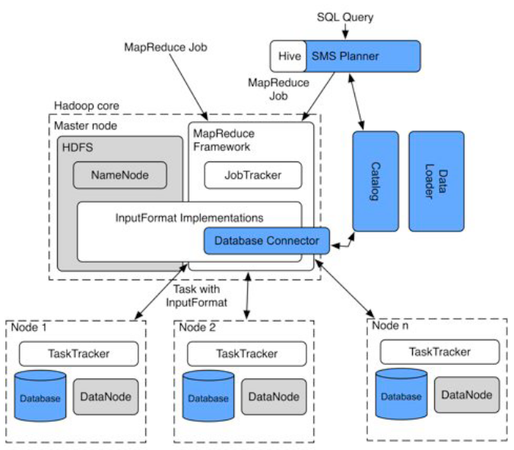
Architecture of HadoopDB

Slide 54
Two-way Joins and MapReduce
MapReduce works with single table:
<key K, value V>
How to use the MR framework to compute:
R(A, B) S(B, C)
Simple extension:
<a, b> from R is mapped as: <b, [R, a]>
<b, c> from S is mapped as: <b, [S, c]>
During the reduce phase:
Join the key-value pairs with the same key but different relations

Slide 55
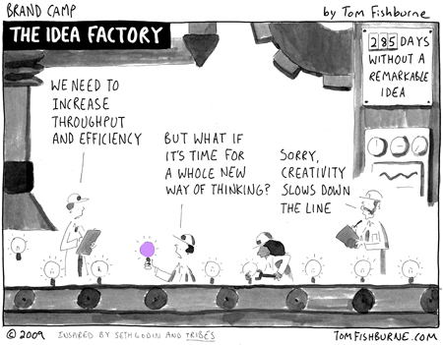
Beyond Two-way Joins?
How to generalize to:
R(A, B) S(B, C) T(C,D)

Slide 56
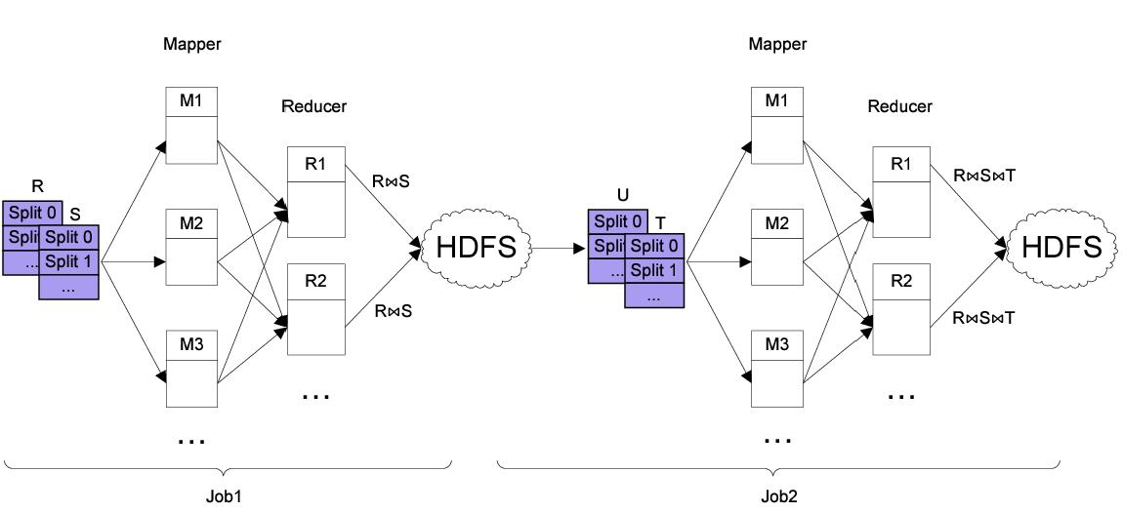
Beyond Two-way Joins

Slide 57
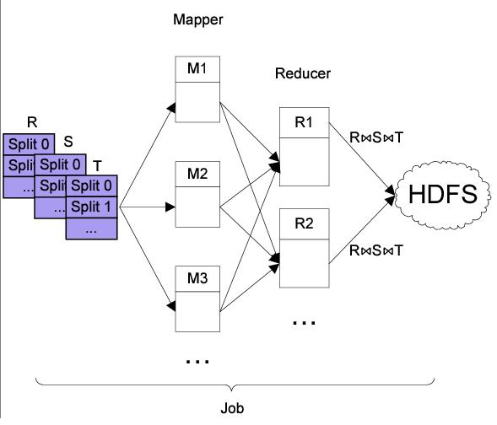
Beyond Two-way Joins?

Slide 58
Multi-way Join [Afrati & Ullman]
R(A,B)
S(B,C)
T(C,D)
h(b,c) | 0 | 1 | 2 | 3 | 4 | 5
0
1
2
3
4
5

Slide 59
OLAP over MapReduce
Multi-way Join over a single MR phase:
One-to-many shuffle
Communication cost:
3-way Join: O(n) communication
4-way Join: O(n²)
…
M-way Join: O(n^{M-2})
Clearly, not feasible for OLAP:
Large number of Dimension Tables
Many OLAP queries involve Join of FACT table with multiple Dimension tables.

Slide 60


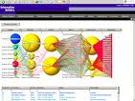

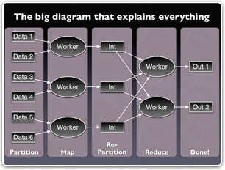


Slide 61
Scalable OLAP
Observations:
STAR Schema (or its variant)
DIMENSION tables typically are not very large (in most cases)
FACT table, on the other hand, have a large number of rows.
Design approach:
Use MapReduce as a parallel and computing substrate
Fact tables partitioned across multiple nodes
Partitioning strategy should be based on the dimension that are most often used as selection constraint in DW queries
Dimension tables are replicated
MAP tasks perform the STAR joins
REDUCE tasks then perform the aggregation

Slide 62
Large-scale data analytics [Guinea Project @ NUS]
Fact table
Use column-based approach for the storage
Each foreign key is partitioned in the same way as the table which it refers to is partitioned
Dimension table
Stored in rows
Small table (which can fit into main memory): replicate to each slave node to join
Big table: partitioned and joined with the fact table in map tasks

Slide 63
Looking Forward New Applications
Deep Statistical Analytics
Data Exploration, Model Evaluation, Outlier Detection, Personalized Recommendation
Challenge: Enable Deep Analysis and Understanding over massive data volumes
Spectrum of Approaches:
Mad Skills [Cohen et al., VLDB 2009], Apache Mahout, Ricardo [Das et al., SIGMOD 2010]

Slide 64
Looking Forward New Applications
Complex data processing – Graphs and beyond
Multidimensional Data service
OLTP & OLAP Convergence?

Slide 65
Outline
Data in the Cloud
Platforms for Data Analysis
Platforms for Update intensive workloads
Data Platforms for Large Applications
Multitenant Data Platforms
Open Research Challenges

Slide 66
Platforms for Update intensive workloads
Most enterprise solutions are based on RDBMS technology.
Significant Operational Challenges:
Provisioning for Peak Demand
Resource under-utilization
Capacity planning: too many variables
Storage management: a massive challenge
System upgrades: extremely time-consuming
Complex mine-field of software and hardware licensing
➔ Unproductive use of people-resources from a company’s perspective

Slide 67
Scaling in the Cloud
Client Site
Client Site
Client Site
Load Balancer (Proxy)
App Server
App Server
App Server
App Server
App Server
MySQL Master DB
MySQL Slave DB
Database becomes the Scalability Bottleneck
Cannot leverage elasticity
Replication

Slide 68
Scaling in the Cloud
Client Site
Client Site
Client Site
Load Balancer (Proxy)
App Server
App Server
App Server
App Server
App Server
MySQL Master DB
Replication
MySQL Slave DB

Slide 69



Scaling in the Cloud
Client Site
Client Site
Client Site
Load Balancer (Proxy)
Apache
+ App Server
Apache
+ App Server
Apache
+ App Server
Apache
+ App Server
Apache
+ App Server
Scalable and Elastic,
but limited consistency and operational flexibility
Key Value Stores

Slide 70
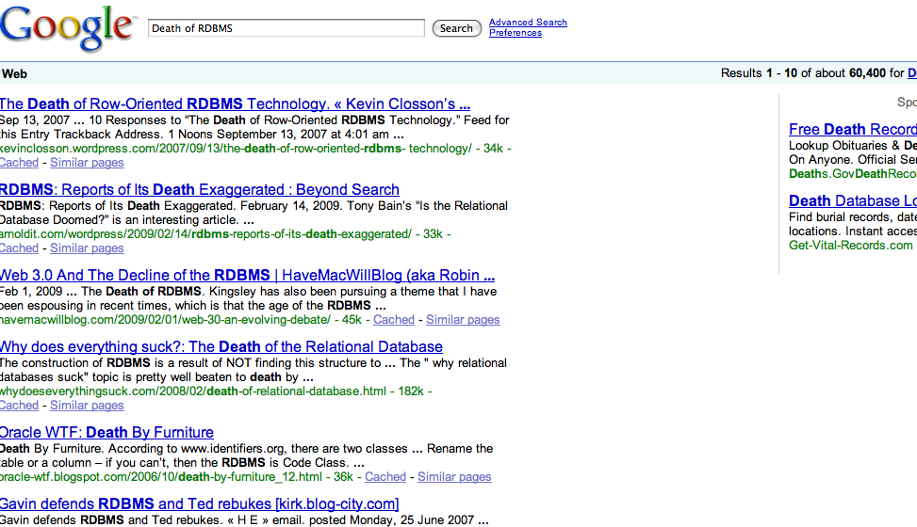
Internet Chatter
Notes:
I wanted to begin my talk by being a bit provocative – and therefore did a Google query “death of RDBMS”. Sure enough – Google responds with more than 60,000 results matching my query.
To be fair – application developers and system designers – especially in the context of Internet application have been clamoring for database scalability for more than a decade ever since Databases became the bottom tier of Web-based service tier. We as database researchers have not paid much attention to this and in fact the state of database technology has remained virtually unchanged for the last 10 years.
So it is not surprising when the BLOGGERS (many of whom have first-hand knowledge of databases) are delighted at the prospect of putting the nails on the RDBMS coffin.
The question I want to ask is – can we redeem ourselves?

Slide 71
BLOG Wisdom
“If you want vast, on-demand scalability, you need a non-relational database.” Since scalability requirements:
Can change very quickly and,
Can grow very rapidly.
Difficult to manage with a single in-house RDBMS server.
Although RDBMS scale well:
When limited to a single node.
Overwhelming complexity to scale on multiple server nodes.

Slide 72
The “NoSQL” movement
Initially used for: “Open-Source relational database that did not expose SQL interface”
Popularly used for: “non-relational, distributed data stores that often did not attempt to provide ACID guarantees”
Gained widespread popularity through a number of open source projects
HBase, Cassandra, Voldemort, MongDB, …
Scale-out, elasticity, flexible data model, high availability

Slide 73
NoSQL has no relation with SQL - Micheal Stonebraker [CACM Blog]
Term heavily used (and abused)
Scalability and performance bottleneck not inherent to SQL
Scale-out, auto-partitioning, self-manageability can be achieved with SQL
Different implementations of SQL engine for different application needs
SQL provides flexibility, portability

Slide 74
No-SQL to Not Only SQL
Recently re-christened
Encompass a broad category of “structured” storage solutions
RDBMS is a subset
Key Value stores
Document stores
Graph database
The debate for correct characterization continues

Slide 75
Cloud Data Management Desiderata SQL or NoSQL
Scalability
Elasticity
Fault tolerance
Self Manageability
Sacrifice consistency?

Slide 76
Sacrificing Consistency Increased Application Complexity
public void confirm_friend_request(user1, user2)
{
begin_transaction();
update_friend_list(user1, user2, status.confirmed);
//Palo Alto update_friend_list(user2, user1, status.confirmed);
//London
end_transaction();
}

Slide 77
public void confirm_friend_request_A(user1, user2){
try{ update_friend_list(user1, user2, status.confirmed); //palo alto }
catch(exception e){ report_error(e); return; }
try{ update_friend_list(user2, user1, status.confirmed); //london }
catch(exception e) { revert_friend_list(user1, user2); report_error(e); return; }
}

Slide 78
public void confirm_friend_request_B(user1, user2){
try{ update_friend_list(user1, user2, status.confirmed); //palo alto }catch(exception e){ report_error(e); add_to_retry_queue(operation.updatefriendlist, user1, user2, current_time()); }
try{ update_friend_list(user2, user1, status.confirmed); //london }catch(exception e) { report_error(e); add_to_retry_queue(operation.updatefriendlist, user2, user1, current_time()); } }

Slide 79
/* get_friends() method has to reconcile results returned by get_friends() because there may be data inconsistency due to a conflict because a change that was applied from the message queue is contradictory to a subsequent change by the user. In this case, status is a bitflag where all conflicts are merged and it is up to app developer to figure out what to do. */
public list get_friends(user1){ list actual_friends = new list(); list friends = get_friends(); foreach (friend in friends){ if(friend.status == friendstatus.confirmed){ //no conflict actual_friends.add(friend); }else if((friend.status &= friendstatus.confirmed) and !(friend.status &= friendstatus.deleted)){ // assume friend is confirmed as long as it wasn’t also deleted friend.status = friendstatus.confirmed; actual_friends.add(friend); update_friends_list(user1, friend, status.confirmed); }else{ //assume deleted if there is a conflict with a delete update_friends_list( user1, friend, status.deleted) } }//foreach return actual_friends; }
It gets too complicated with Eventual Consistency

Slide 80

Perspectives (James Hamilton)
I love eventual consistency but there are some applications that are much easier to implement with strong consistency. Many like eventual consistency because it allows us to scale-out nearly without bound but it does come with a cost in programming model complexity.
February 24, 2010

Slide 81
Quest for Scalable, Fault-tolerant, and Consistent Data Management in the Cloud

Slide 82
Coffee Break

Slide 83
References
[Dean et al., ODSI 2004] MapReduce: Simplified Data Processing on Large Clusters, J. Dean, S. Ghemawat, In OSDI 2004
[Dean et al., CACM 2008] MapReduce: Simplified Data Processing on Large Clusters, J. Dean, S. Ghemawat, In CACM Jan 2008
[Dean et al., CACM 2010] MapReduce: a flexible data processing tool, J. Dean, S. Ghemawat, In CACM Jan 2010
[Stonebraker et al., CACM 2010] MapReduce and parallel DBMSs: friends or foes?, M. Stonebraker, D. J. Abadi, D. J. DeWitt, S. Madden, E. Paulson, A. Pavlo, A, Rasin, In CACM Jan 2010
[Pavlo et al., SIGMOD 2009] A comparison of approaches to large-scale data analysis, A. Pavlo et al., In SIGMOD 2009
[Abouzeid et al., VLDB 2009] HadoopDB: An Architectural Hybrid of MapReduce and DBMS Technologies for Analytical Workloads, A. Abouzeid et al., In VLDB 2009
[Afrati et al., EDBT 2010] Optimizing joins in a map-reduce environment, F. N. Afrati, J. D. Ullman, In EDBT 2010
[Agrawal et al., SIGMOD 2009] Asynchronous view maintenance for VLSD databases, P. Agrawal et al., In SIGMOD 2009
[Das et al., SIGMOD 2010] Ricardo: Integrating R and Hadoop, S. Das et al., In SIGMOD 2010
[Cohen et al., VLDB 2009] MAD Skills: New Analysis Practices for Big Data, J. Cohen et al., In VLDB 2009

